Slide 1



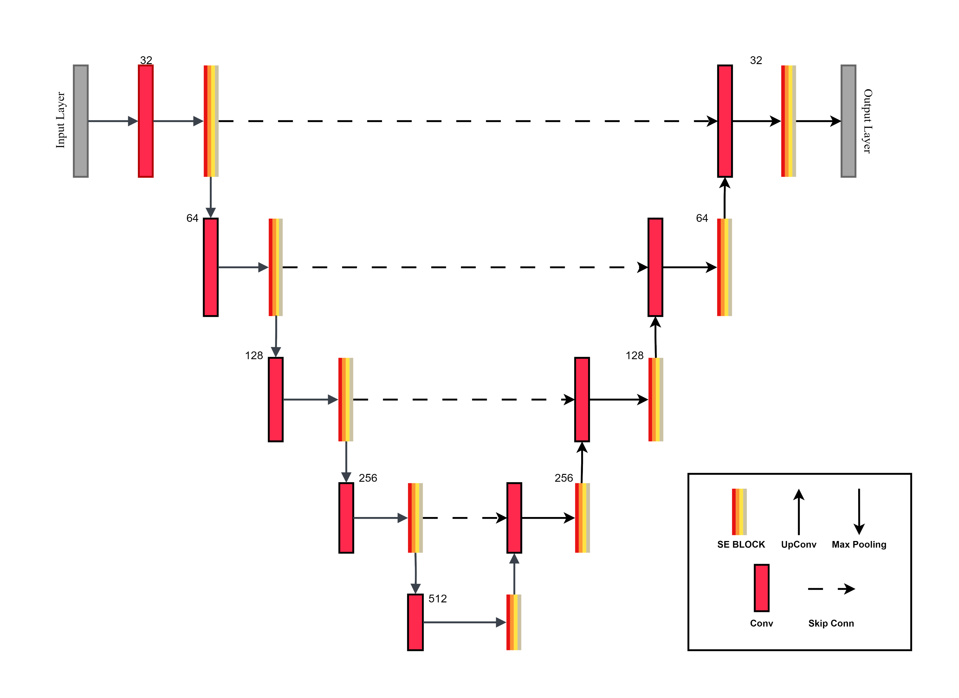
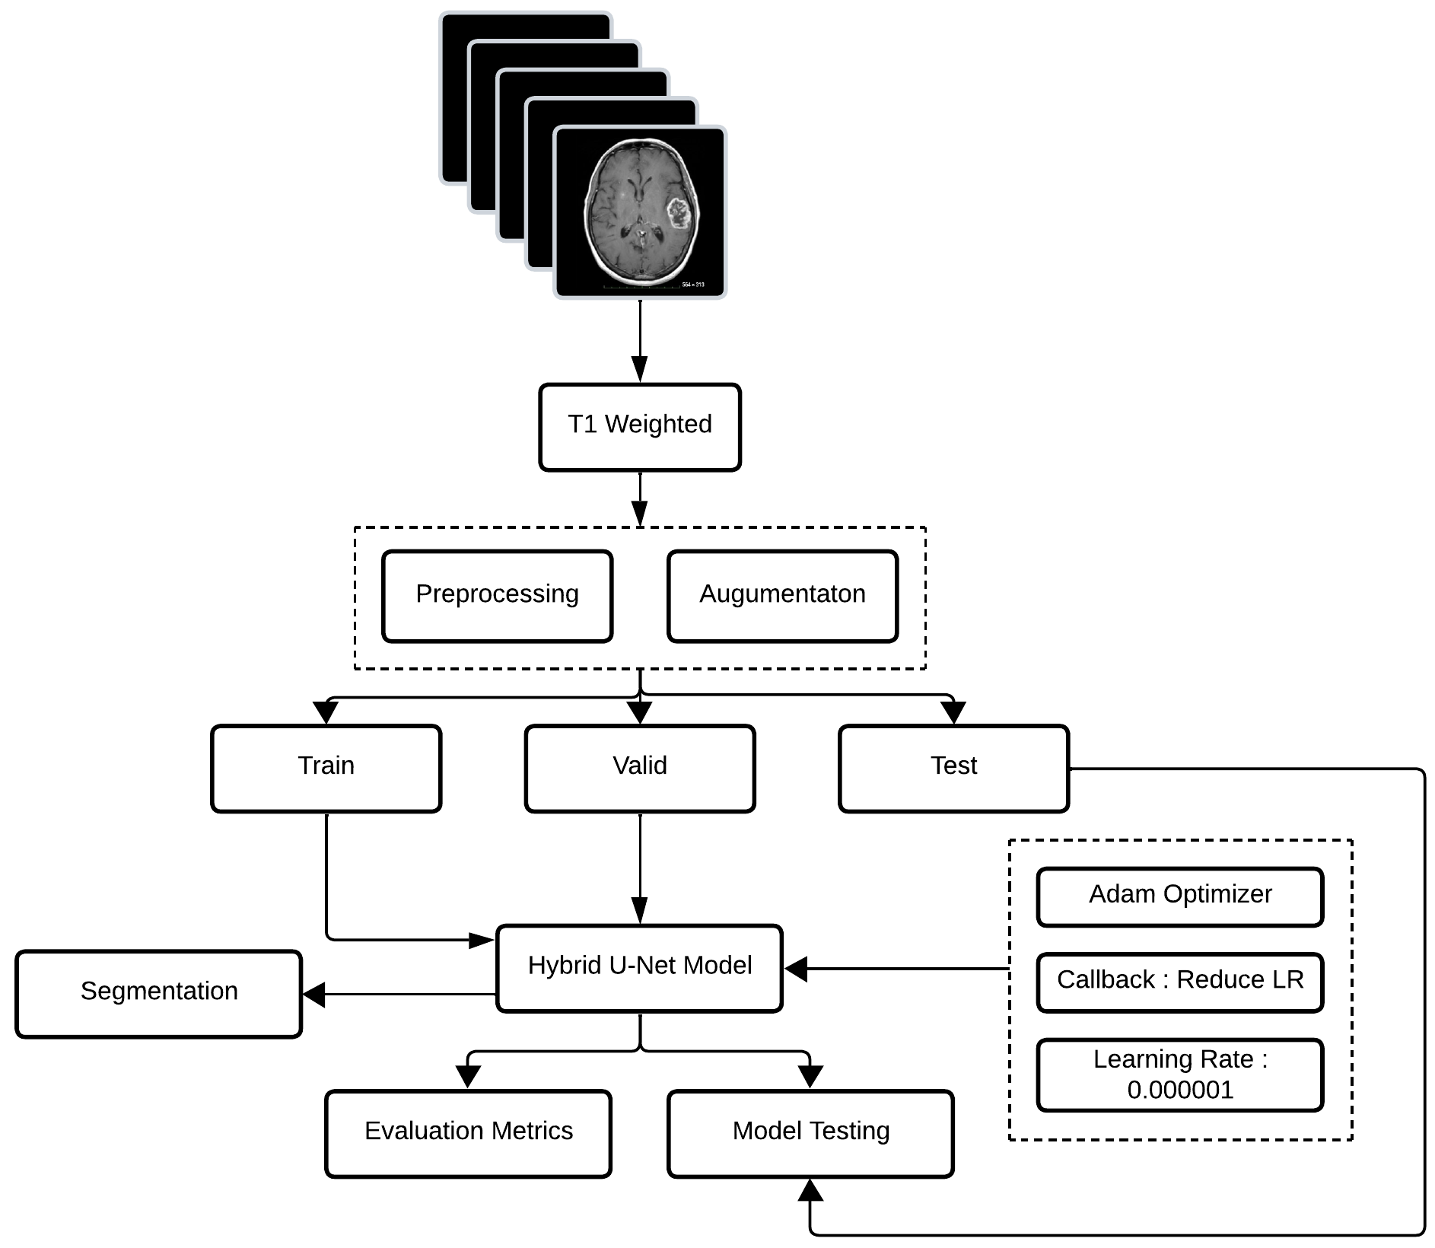
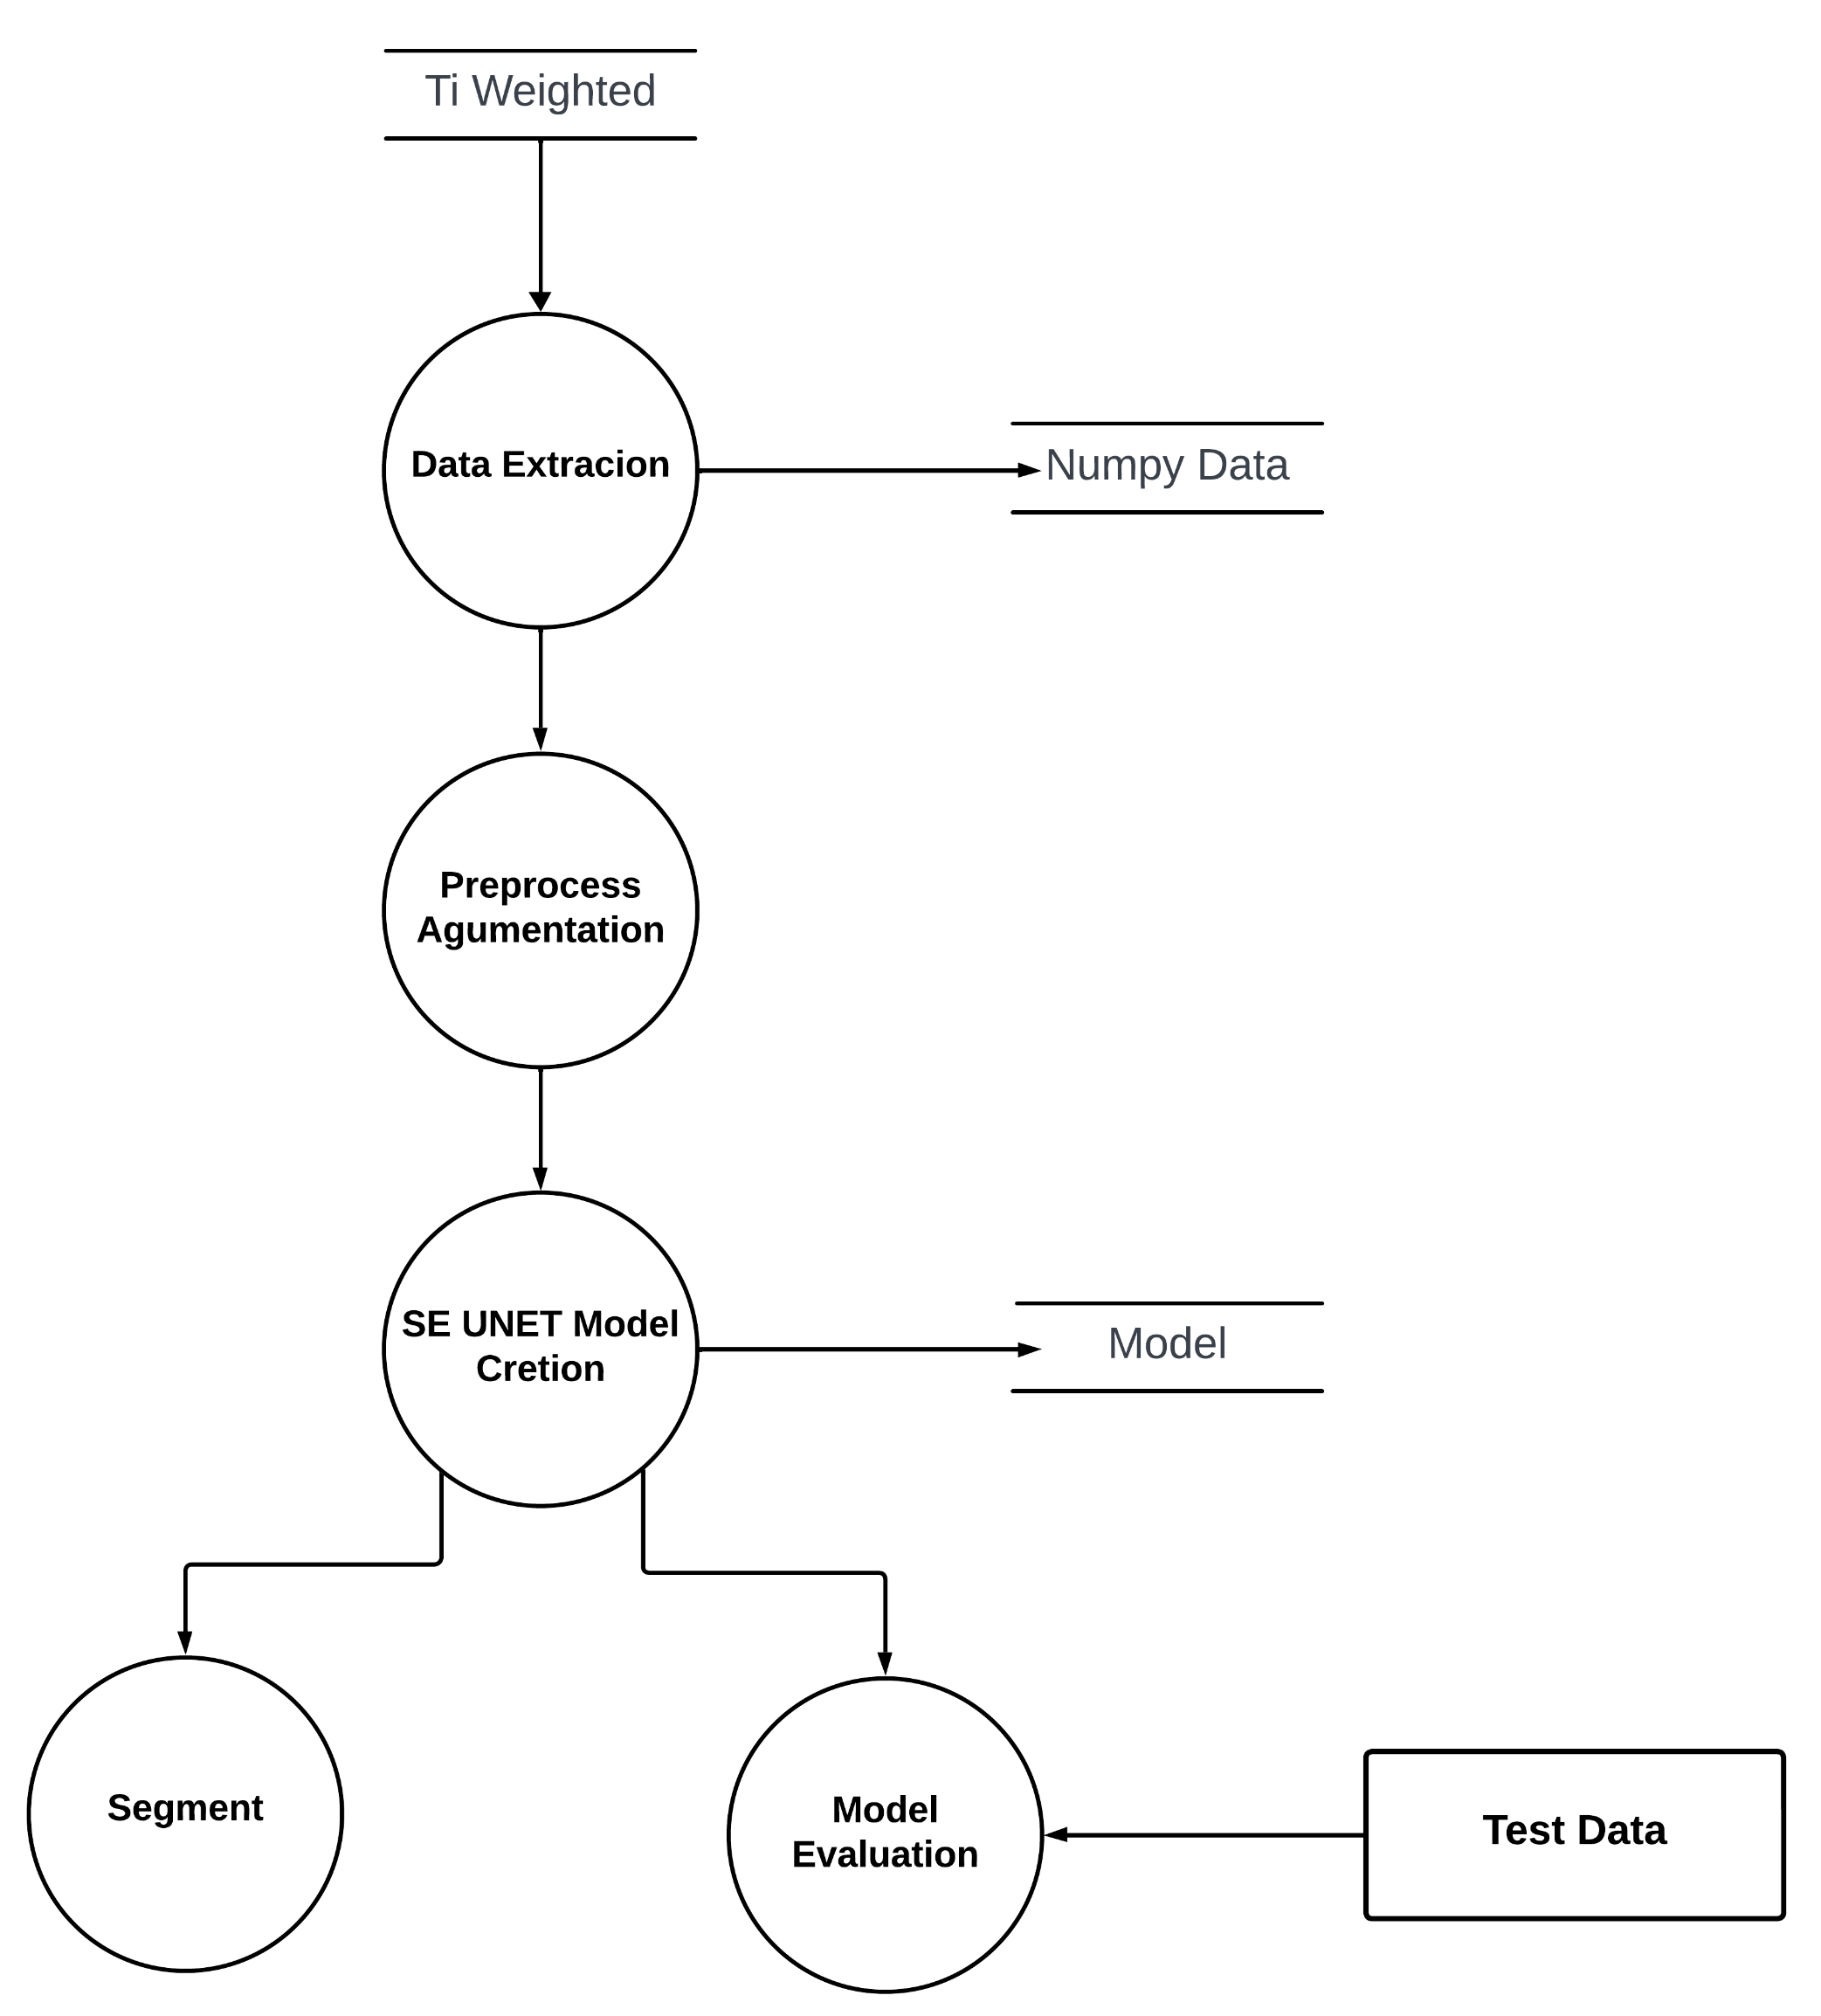
SEGMENTING BRAIN TUMOR ON MRI IMAGES USING LIGHWEIGHT SE UNET MODEL
Department of Computer Science and Engineering Batch: (2020-2024)
School of Computing
1156CS701-MAJOR PROJECT
INHOUSE
WINTER SEMESTER 2023-2024
ABSTRACT
All over the world, the leading cause of people’s death is cancer. The most common types of cancer are brain, breast, colon, lung, prostate, rectum, and skin. Cancer is nothing but a group of abnormal cells that grow beyond the limited boundaries. It infiltrates and destroys normal body tissue, and makes it hard for people to survive. Brain tumor has the highest death rate compared to other cancer-affected people. In America (2023), 94,390 people have been diagnosed and their relative survival rate is 35.7%.
Survival rates depend on the grade (low grade and high grade) and prognostic factors of the tumor. Medical heads are doing their best to cure but there are many unknown reasons behind the formation of tumors. Brain tumors are diagnosed with the help of Magnetic Reasoning Imaging (MRI) and Computed Tomography (CT) Scan. There are many automated segmentation and classification techniques available in Deep Learning (DL) with base UNET architecture but there are some disadvantages that come along with it like more time to train, higher convergence rate, repeated layer, and so on.
With the help of MRI data along with its T1 modalities, we are proposing a 2- dimensional hybrid architecture with a combination of Squeeze- and-Excitation (SE) to suppress the irrelevant feature to make up the issue of redundancy, and U-NET as a base architecture. Our hybrid architecture provides significant performance while evaluating the T1 dataset from the Figshare repository. The results obtained through our architecture are accuracy, loss, precision, etc. are mentioned along with hyper-parameters used and tested with our model.
INTRODUCTION
RESULTS
STANDARDS AND POLICIES
Over the past few decades, the field of medical imaging has undergone a revolution with the application of machine learning and deep learning algorithms for the segmentation, identification, and prediction of patient survival from tumors or other diseases. ​
In addition, it helps doctors make an early diagnosis of malignant brain tumors, thus improving the prognosis. Gliomas occur most often in adults and are thought to arise from glial cells and invade adjacent tissues. ​
The primary brain tumor is a glioma. High-Grade Glioblastoma (HGG) and Low-Grade Glioblastoma (LGG) are two other subtypes of glioma. While radiologists manually reviewed Magnetic Resonance Imaging (MRI) modalities to generate quantitative information, segmentation of 2D modalities is cumbersome, with variations and errors.
This challenge is further heightened if tumors vary in size, shape, and location. Tumor-like cells can appear anywhere in brain tissue and can vary in size, appearance, and shape, and it is difficult to automatically segment brain tumors and their subregions. CNNs of different architectures have and use automatic segmentation.
We made a lightweight U-NET architecture by integrating SE block to help physicians improve their performance by performing analyses with the automatic and intelligent systems provided.
The proposed system of Lightweight SE U-Net architecture for brain tumor segmentation which used the T1 Weighted dataset of the patients which is maintained privately. This model provides an accuracy of nearly 98.4 percent which is much greater than the existing system CNN and UNET models. As SE U-Net is specially designed for medical usage, it gives more advantages for the training and validation phase by reducing time taken to train and consume less Graphics.
Google Colab
Google Colab adheres to Google Cloud Platform’s policies and terms of service, ensuring the security and privacy of user data and resources. Google Colab users are expected to comply with Google’s Acceptable Use Policy, which prohibits activities such as spamming, distributing malware, and engaging in illegal activities. Users are responsible for ensuring the confidentiality and security of their data and code while using Google Colab. It is recommended to avoid storing sensitive information or proprietary data on Colab instances. Google Colab provides integration with Google Drive for saving and loading files, enabling users to store and access data securely. Google Colab instances have automatic shutdown mechanisms to conserve resources and prevent abuse.
Standard Used: ISO/IEC 27001
CONCLUSIONS
The lightweight SE U-Net architecture-based brain tumor segmentation system has demonstrated remarkable performance, with a Dice coefficient of 83%, a loss of 1.5%, and an accuracy of 98.4%. These scores highlight how well the algorithm can identify tumor areas from T1-weighted MRI images. In addition to its functionality, the system has many advantages in the field of medical imaging. First off, doctors may make more confident decisions because of their high accuracy and robustness, which help in more precise diagnosis and treatment planning for patients with brain tumors. Healthcare workers are also less burdened by the automation of the segmentation process, which saves time and money while guaranteeing consistent and trustworthy outcomes. Furthermore, the system’s scalability and usefulness in various clinical contexts are improved by its capacity to manage big datasets and adjust to variations in imaging techniques. The technology quickens the pace of neuroimaging research and development by optimizing the segmentation workflow, opening the door to discoveries in brain tumor pathology and better patient outcomes. All things considered, the brain tumor segmentation technique is a noteworthy development in medical image analysis, providing real advantages to patients and healthcare professionals.
METHODOLOGIES
Figure 1. SE UNET Architecture
The dataset was obtained from Figshare, a reliable source that is well-known for housing datasets that are openly accessible. It contains labels designating the tumor locations, matching mask images, and T1-weighted MRI images. Python’s proper data loading mechanisms are used to retrieve and load the dataset into memory. Once loaded, the data is kept in the numpy array format. Preprocessing entails performing different changes to improve the consistency and quality of the data. This includes using geometric transformations to increase the dataset’s unpredictability, including flipping and transposing. To further guarantee consistency throughout the collection, methods like filling in surrounding areas and scaling the photos to a uniform resolution of 128x128 pixels are used. The model architecture is built on a lightweight SE U-Net, which combines the adaptive feature recalibration offered by SE blocks with the efficiency of a U-Net design. To keep track of the model’s performance and avoid overfitting, the dataset is divided into training and validation sets during the training process. Using optimization methods like Adam, the model parameters are iteratively updated during the training phase. The performance of the trained segmentation model on unknown data to produce segmentation results. The accuracy and robustness of the model are measured using evaluation metrics including the Dice coefficient, accuracy, and loss.
TEAM MEMBER DETAILS
<Logeshwaran K S VTU15366>
<Anisha Devi K VTU17604>
<7092200602>
<9963891517>
<vtu15366@veltech.edu.in>
<vtu17604@veltech.edu.in>
ACKNOWLEDGEMENT
Project Supervisor Name: Dr. S. Saran Raj (Assistant Professor)
Project supervisor Contact No: 8122535491
Project supervisor Mail ID: saranraj@veltech.edu.in
Figure 2. General Architecture of the Proposed System
Figure 3. Data Flow Diagram

